Slide 1


Student Details
NAME: ACHYUTA KUMAR CHOUDHURY
2041003027.achyutakrchoudhury@gmail.com
ORGANIZATION: DGT
COLLEGE NAME: SOA UNIVERSITY
STATE: ODISHA
DOMAIN:DATA ANALYTICS
S/E DATE:12.06.2023-24.07.2023

Slide 2
PROJECT TITLE/Problem Statement: ANALYSIS OF SUPERSTORE DATASET
The goal of this project is to analyze the Superstore dataset to gain insights into sales trends, customer behavior, and operational efficiency. The dataset contains information about various aspects of the store's operations, including sales, customer demographics, product categories, and geographical regions. By conducting a comprehensive analysis, we aim to identify opportunities for improvement and make data-driven recommendations to optimize store performance.
.

Slide 3
AGENDA
Sl. No | Topics Name | Page No.
1 | Introduction | 1
2 | Project Title | 2
3 | Project Overview | 4-8
4 | Results | 9
5 | Links | 10

Slide 4
PROJECT OVERVIEW
The analysis on Superstore dataset is a comprehensive study that aims to analyze the sales performance of a fictional retail company called "Superstore". The dataset used in this analysis contains information about sales transactions, customers, products, and geographical locations.
Purpose: The purpose of the "Analysis of Superstore dataset" is to gain insights into sales trends, customer behavior, and operational efficiency in order to optimize store performance and make data-driven recommendations for improvement.
Scope: The scope of the analysis includes examining the Superstore dataset, which consists of sales transactions, customer demographics, product categories, and geographical regions. The analysis will involve data cleaning, exploratory data analysis, sales analysis, customer behavior analysis, and operational efficiency analysis.
Objectives:
•Identify sales trends, such as seasonal patterns and fluctuations, to optimize inventory management and sales forecasting.
•Understand customer behavior by analyzing demographics, preferences, and purchase patterns to develop targeted marketing strategies and enhance customer satisfaction.
•Improve operational efficiency by identifying bottlenecks, streamlining processes, and optimizing resource allocation for enhanced profitability.
•Provide data-driven recommendations to optimize store performance, improve customer experience, and increase overall profitability based on the analysis findings.

Slide 5
WHO ARE THE END USERS of this project?
WHO ARE THE END USERS:
Target Audience or End Users:
•Store Managers: They require insights on sales performance, customer behavior, and operational efficiency to make informed decisions and optimize store operations.
•Marketing Managers: They need information on customer demographics, preferences, and buying patterns to develop targeted marketing campaigns and improve customer engagement.
Characteristics and Needs:
•They seek comprehensive data analysis, visualizations, and actionable recommendations to identify areas for improvement, enhance profitability, and streamline operations.
Benefits from the Solution:
•They will benefit from optimized inventory management, improved sales forecasting, and streamlined operations, leading to increased profitability and better customer satisfaction.
•They will benefit from targeted marketing campaigns, enhanced customer engagement, and improved customer retention, resulting in increased sales and brand loyalty.

Slide 6
YOUR SOLUTION AND ITS VALUE PROPOSITION
The solution for the "Analysis of Superstore dataset" project involves conducting a comprehensive analysis of the Superstore dataset to gain insights into sales trends, customer behavior, and operational efficiency. This analysis will be carried out using various statistical and data mining techniques, as well as advanced visualization tools. Value Proposition: Our solution provides the following value propositions:
•Data-Driven Decision Making: By analyzing the Superstore dataset, we enable data-driven decision making for store managers and marketing managers. They can make informed decisions based on comprehensive analysis, leading to improved store performance, optimized operations, and targeted marketing strategies.
•Enhanced Profitability: Our analysis helps identify opportunities for increasing sales, improving inventory management, and reducing costs, ultimately leading to enhanced profitability for the Superstore. By optimizing pricing strategies, identifying high-demand products, and streamlining operations, the store can maximize its revenue and profitability.

Slide 7
How did you customize the project and make it your own
Advanced Visualization with Matplotlib : While data visualization is a common component of data analysis projects, my solution stands out by utilizing the powerful libraries Matplotlib. These libraries offer extensive customization options, allowing for the creation of visually appealing and insightful charts, graphs, and plots. By leveraging the capabilities of Matplotlib, my solution presents data in a visually engaging manner, enhancing the understanding of complex patterns and relationships within the Superstore dataset.
Interactive Dashboards: To provide an exceptional user experience, my solution incorporates interactive dashboards. These dashboards allow stakeholders to dynamically explore and interact with the analyzed data, enabling them to drill down into specific details, apply filters, and visualize different dimensions. The interactive nature of the dashboards enhances engagement, facilitates deeper insights, and empowers users to derive actionable recommendations effectively.
Descriptive Analytics: Utilize descriptive analytics techniques to summarize and present key information about sales trends, customer behavior, and operational performance within the Superstore dataset. This includes calculating summary statistics, generating frequency distributions, and identifying important patterns or trends.
Forecasting and Trend Analysis: Apply forecasting methods and trend analysis to predict future sales trends and demand patterns.

Slide 8
MODELLING
•Exploratory Data Analysis (EDA):EDA techniques were employed to gain initial insights into the dataset. This included data visualization through charts, graphs, and plots to understand the distribution of variables, identify outliers, and detect patterns or relationships between different variables.
•Statistical Analysis: Utilized to uncover correlations, trends, and patterns within the Superstore dataset. These techniques helped in understanding the impact of various factors on sales.
•Customer Segmentation: applied o categorize customers based on their attributes and buying behavior. This allowed for the identification of distinct customer groups with specific needs and preferences, enabling targeted marketing strategies.
•Data Visualization: Advanced data visualization techniques using tools like Python libraries (e.g., Matplotlib) were used to create visually appealing and informative charts, graphs, and dashboards. These visualizations facilitated the effective communication of analysis results and provided a clear representation of key findings.
These modeling techniques, methodologies, and frameworks formed the foundation of the "Analysis of Superstore dataset" project for Data Analytics, ensuring a systematic and data-driven approach to extract valuable insights from the dataset.

Slide 9
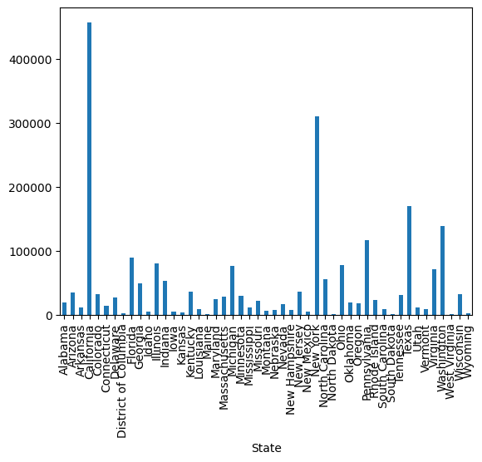
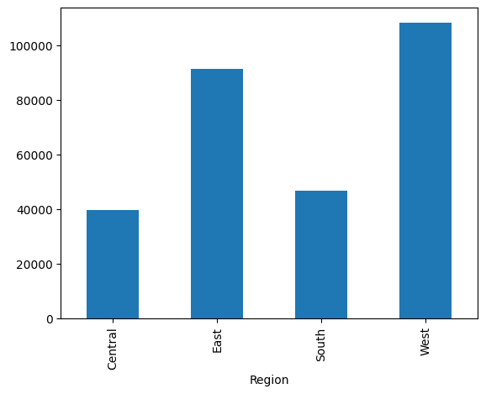
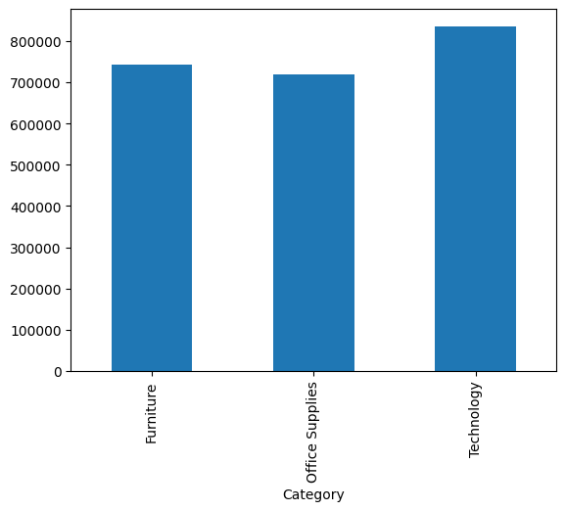
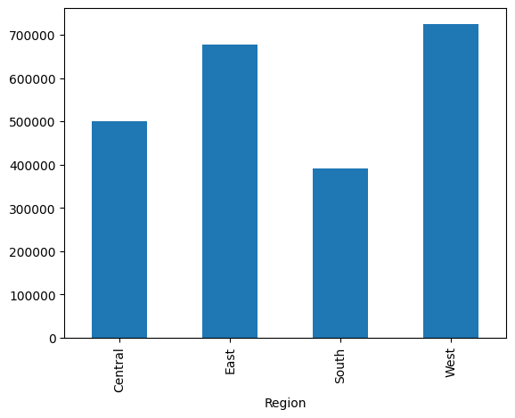
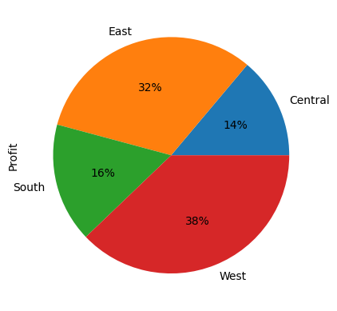
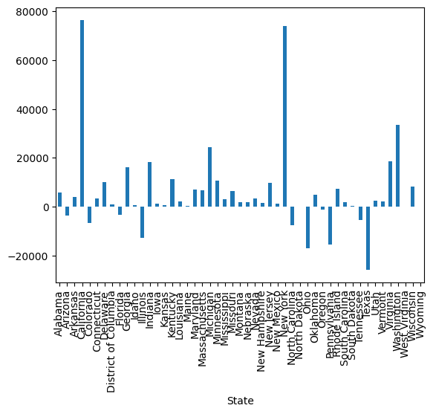
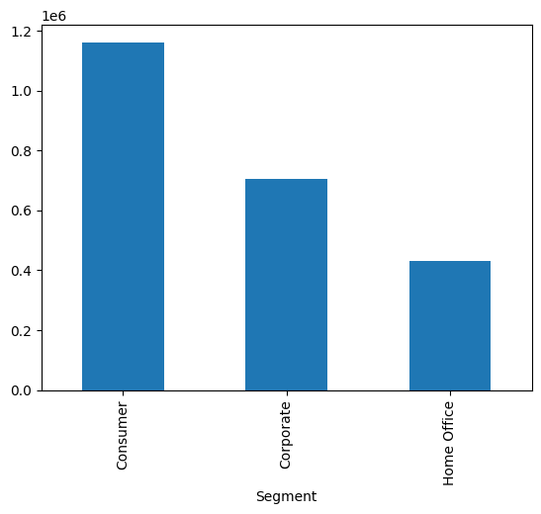
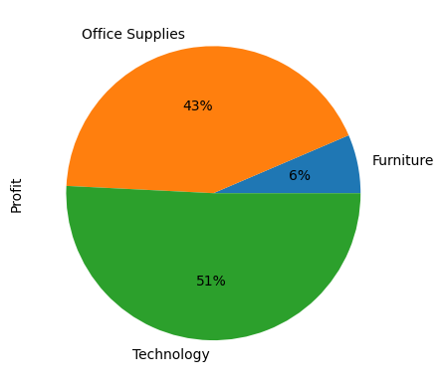
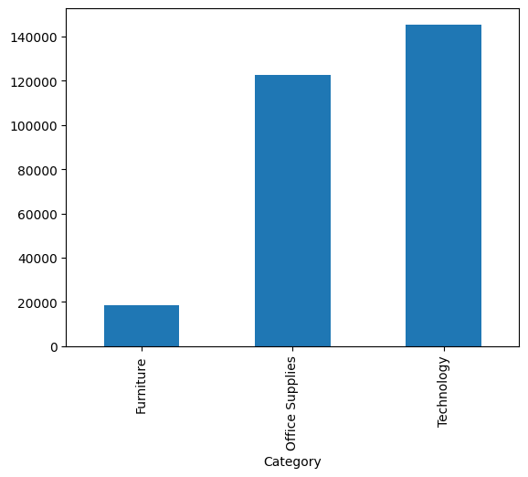
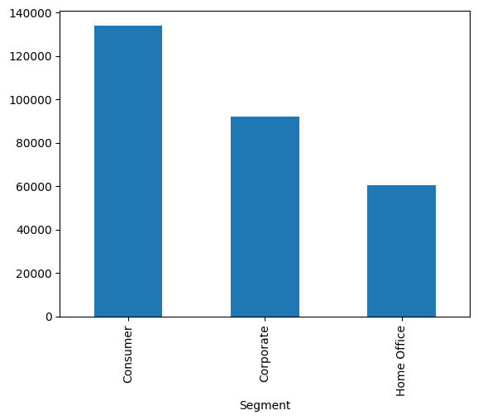
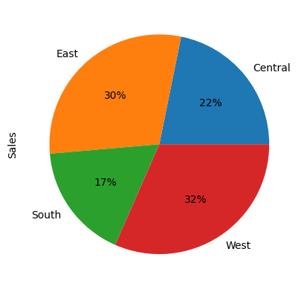
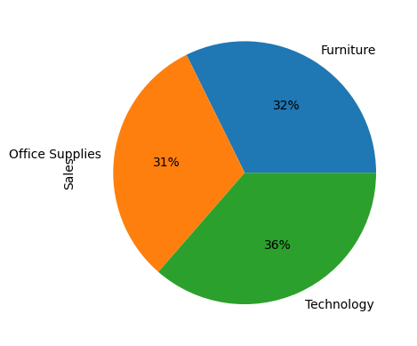
Results

Slide 10
links
Github link: https://github.com/achyutstyles/Analysis-of-Superstore-
Dataset: https://www.kaggle.com/datasets/vivek468/superstore-dataset-final

